Slide 1


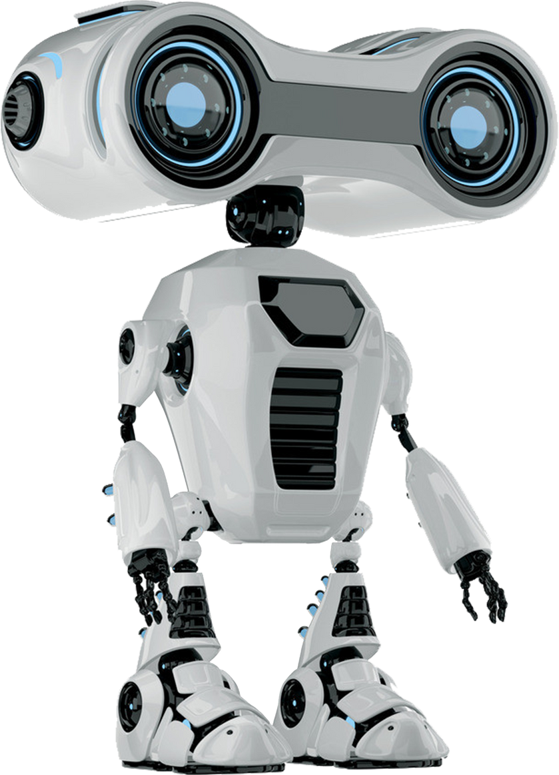
OBSTACLE
AVOIDING
ROBOT
PRESENTED BY
ZAYEED HASAN - 20210204032
MIRZA NAEEM BEG - 20210204033
SALIM ULLAH SADIK - 20200204085

Slide 2
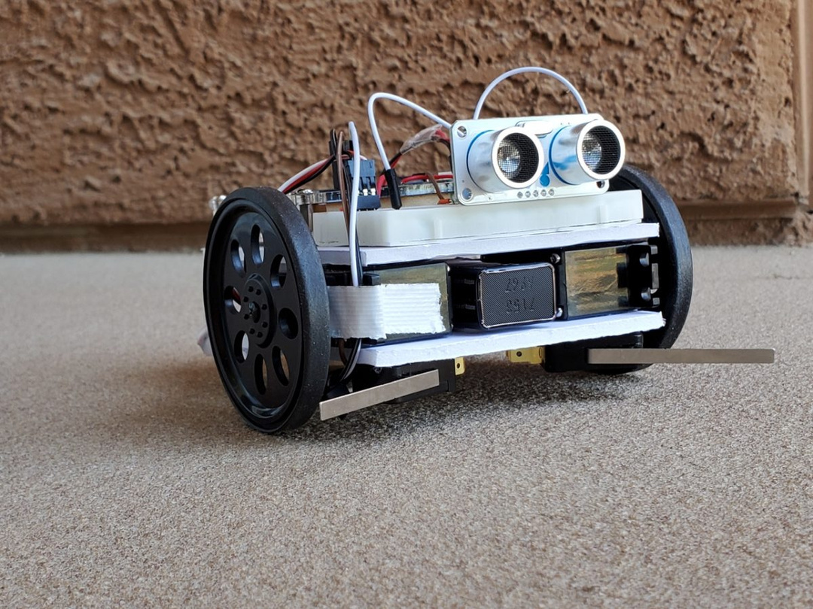
ABOUT THE PROJECT
The project is about creating an Obstacle Avoiding Robot using Arduino. This autonomous robot can detect and avoid obstacles in its path. When an obstacle is detected, it stops, reverses, looks for a clear path, and proceeds in that direction. This concept is foundational for advanced projects like automatic cars and manufacturing robots.

Slide 3
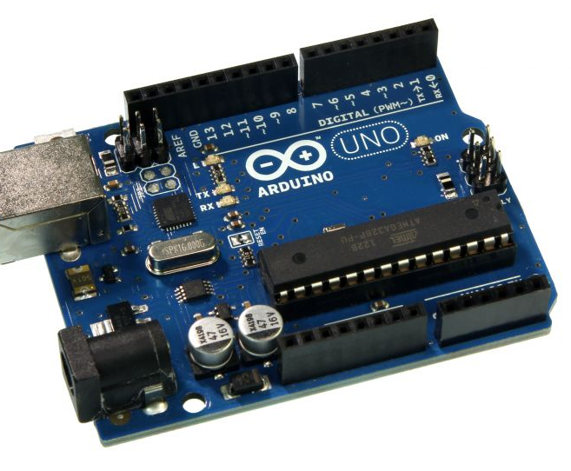
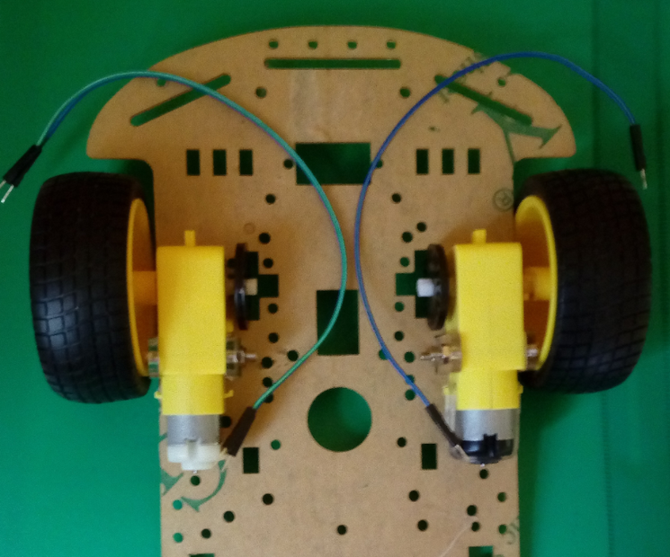
COMPONENTS
Arduino UNO
01
Smart robot car chassis
02

Slide 4
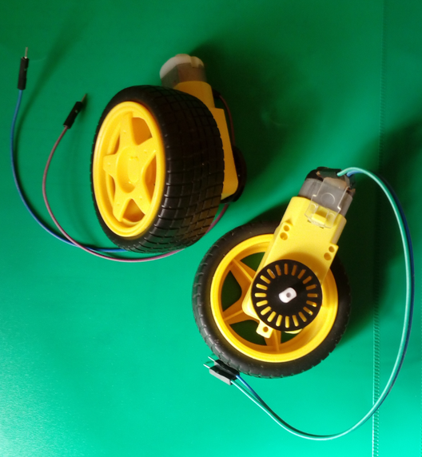
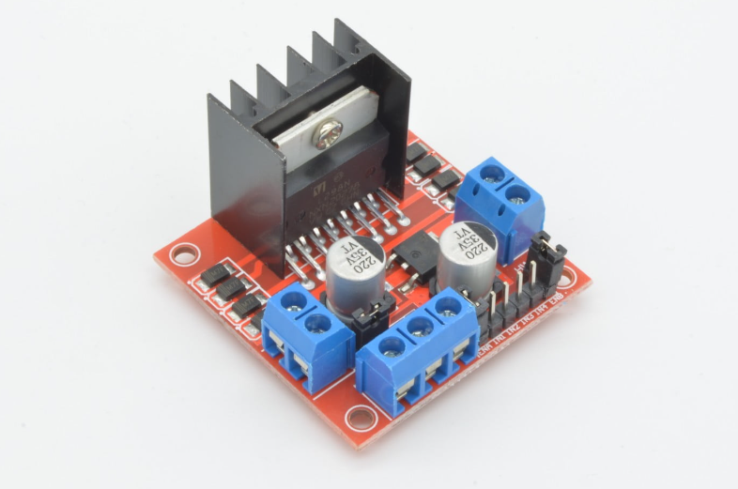
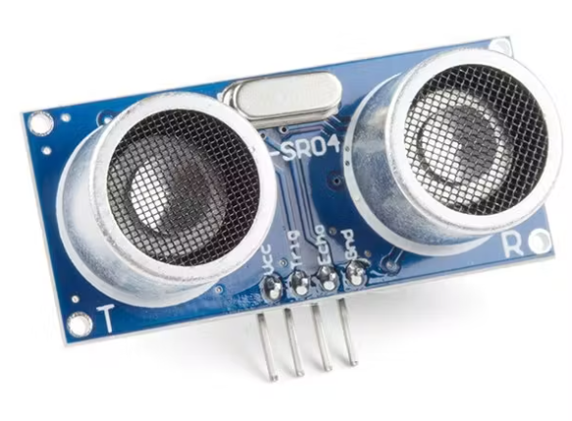
TWO DC MOTORS WITH WHEELS
03
L298n moto driver
HC-SR04
04
05
COMPONENTS

Slide 5
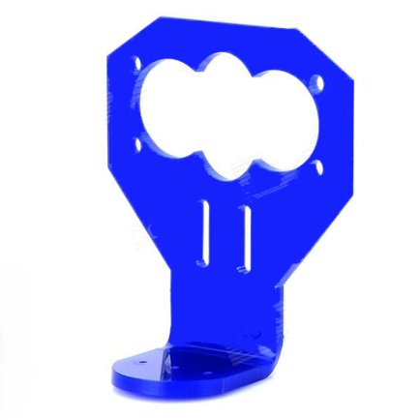
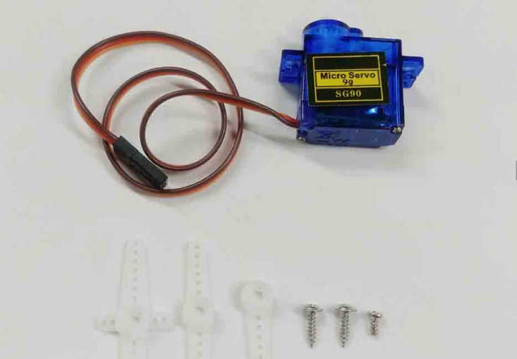

7.4V 1300mah Lipo battery
06
TowerPro microservo 9g
mounting bracket
07
08
COMPONENTS

Slide 6

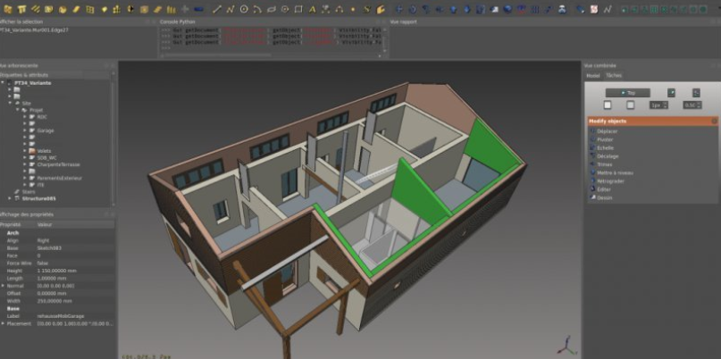
SOFTWARES
ARDUINO IDE
CAD SOFTWARE

Slide 7
BUDGET
Arduino UNO
01
710 BDT
Smart robot car chassis
02
250 BDT

Slide 8
TWO DC MOTORS WITH WHEELS
310 BDT
03
L298n moto driver
HC-SR04
04
05
250 BDT
250 BDT
COMPONENTS

Slide 9
7.4V 1300mah Lipo battery
06
600 BDT
TowerPro microservo 9g
mounting bracket
07
08
150 BDT
60 BDT
COMPONENTS

Slide 10
SOCIAL AND ECONOMIC BENEFITS
Social Benefits :
Enhanced Safety: Autonomous robots like Agrodoot can perform tasks in hazardous environments, reducing the risk of injury to human workers.
Accessibility: Agrodoot can assist individuals with disabilities by navigating through spaces and performing tasks that may be challenging for them.

Slide 11
SOCIAL AND ECONOMIC BENEFITS
Economic Benefits :
Increased Efficiency: In industrial settings, obstacle-avoiding robots like Agrodoot can streamline production processes, reduce downtime, and increase productivity.
Cost Savings: Automating repetitive tasks can lead to significant cost savings by reducing the need for human labor and minimizing errors.

Slide 12
MULTIDISCIPLINARY
Mechanical Engineering
Electrical Engineering
Computer Engineering

Slide 13
THANK YOU

